Slide 1
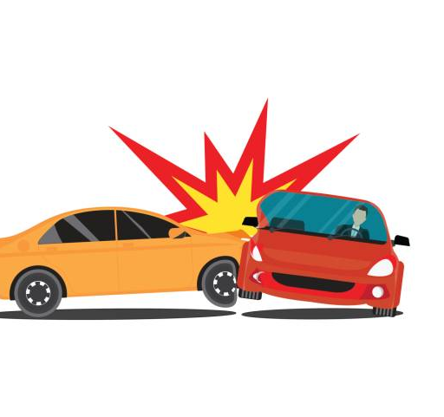
Topic: Insurance Proceeds
Panel Members:
Alice Whitten
Steve Wilcox
Mark French

Slide 2
You are Debtor’s counsel. Debtor calls and says that they have been in a motor vehicle accident and that their car is totaled.
How do you respond?
What questions do you need to ask?

Slide 3
In general, what are vehicle lenders looking for when the vehicle is damaged in an accident?
What actions should counsel for the vehicle lender take?

Slide 4
What is the result if the insurance proceeds have been received by the Debtor and spent when you learn of the accident?

Slide 5
What if the vehicle is not a total loss?
How does that change the dynamic?

Slide 6
What if the available insurance proceeds are not enough to pay the vehicle lender’s allowed secured claim?

Slide 7
What if the available insurance proceeds are enough to pay the vehicle lender’s allowed secured claim, but not enough to pay the unsecured portion of the claim?

Slide 8
Your Client receives an insurance check, for vehicle repairs, made payable to your Client and the Lender
What are the rights of the Debtor, the Lender and the Trustee in regards to these funds?
How should Debtor’s counsel proceed?

Slide 9
Lender’s counsel receives an insurance check made payable to their Client and the Debtor
What are the rights of the Lender, the debtor and the Trustee with regards to these funds?
How should lender’s counsel proceed?

Slide 10
After a hailstorm, the Debtor gets an insurance check for a new roof.
What claims do the lender, Client and Trustee have regarding the funds?

Slide 11
What is the process for the Debtor to get another vehicle?

Slide 12
What sort of factors does a vehicle lender consider when deciding whether to work with the debtors or insist on getting the proceeds?

Slide 13
Questions?

